Slide 1
Animal Classifier
By: Drew Wheeler, Brian Lee , Carlos Escudero, Hunter Evans, Robert Zheng

Slide 2
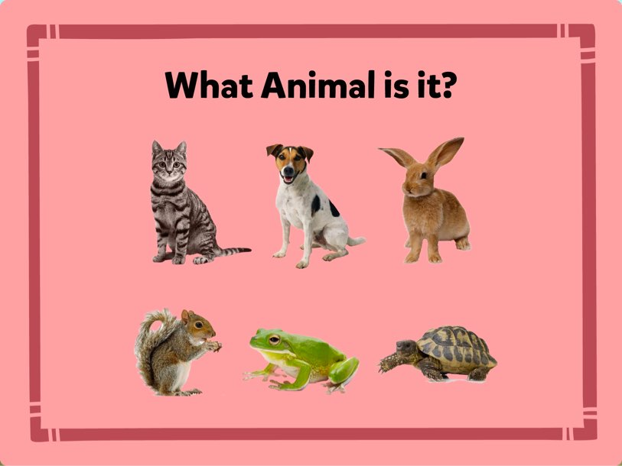
Topic
Animal Classification Agent
Given image, it will tell you what animal
Motivation: We wanted to gauge performance between two models for a classification problem.

Slide 3
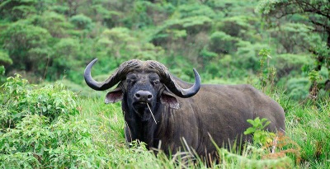
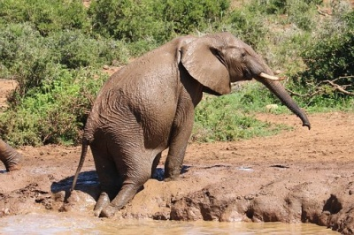
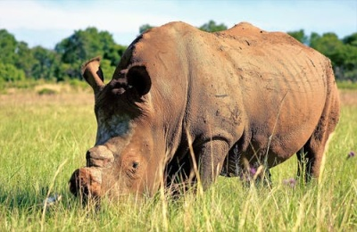
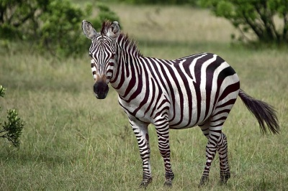
Data
Kaggle
Dataset contains 4000 total images
Buffalo, elephant, rhino, and zebra
Augmented data to better train model
Ex: black and white

Slide 4
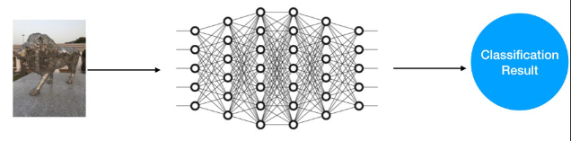
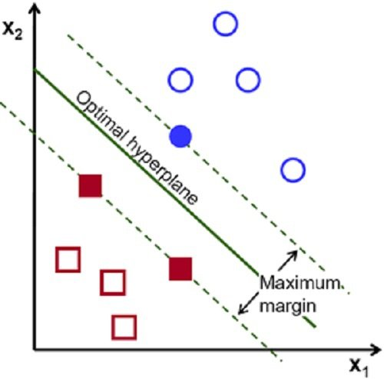
Algorithms
DNN (Deep Neural Network)
Multi-layered neural network
Layers sequentially transform input data into an abstract representation.
Deep networks extract features better
Several layers increases computational complexity of DNNs over standard ANNs.
SVM (support vector machine)
Vectors of features plotted as data points
Line/hyperplane that separates different groups of data
Goal = maximize margin so distinction is clear
Orange used to apply algorithms

Slide 5
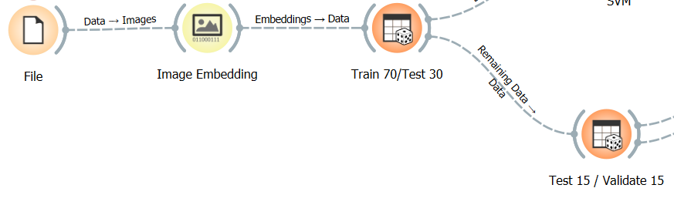
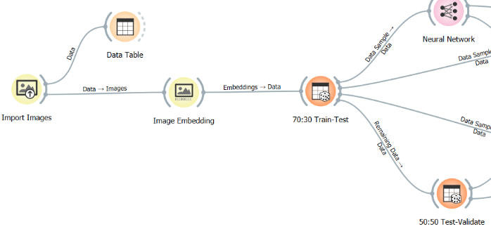
Preprocessing The Data
Python script to put images in csv file
Import csv file
Differences in SVM vs DNN
Image embedding powered by Inception v3
Uses CNN
Turns images into a vector of features/numbers
Split data into training and testing data set
Split test data again

Slide 6
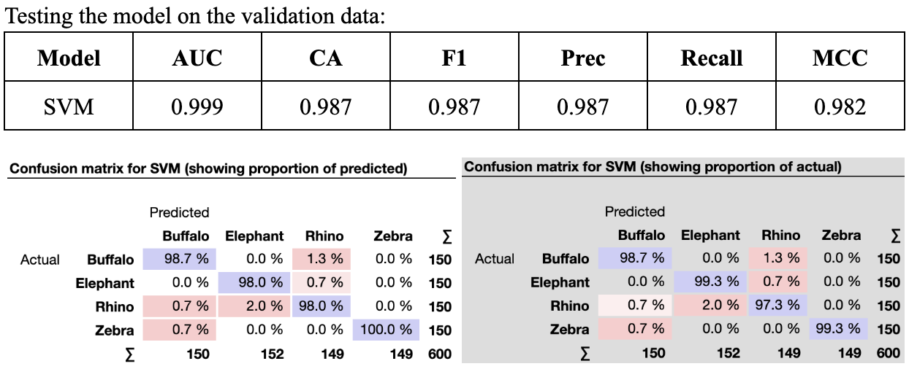
Pre-Tuning SVM Evaluation
Final result of testing the model on validation data before model tuning
Explanation of the figure {talk about model tuning (default values), table, Conf Matrix}
Default Model Tuning {Default Values (C = 1.00, Numerical tolerance = 0.0001, Iteration limit = 100)}

Slide 7
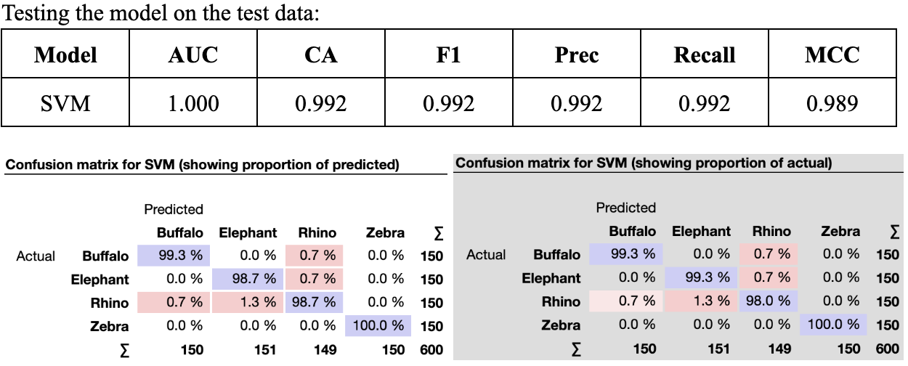
Pre-Tuning SVM Evaluation
Final result of testing the model on test data before model tuning
Explanation of the figure {talk about model tuning (default values), table, Conf Matrix}
Default Model Tuning {Default Values (C = 1.00, Numerical tolerance = 0.0001, Iteration limit = 100)}

Slide 8
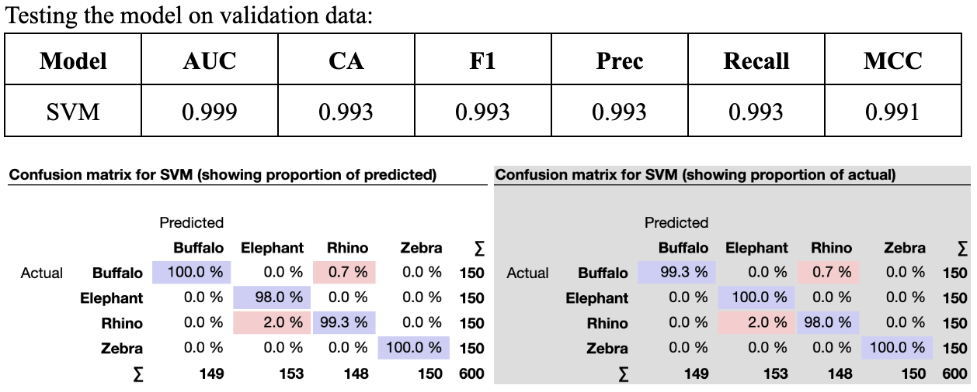
Post-Tuning SVM Evaluation
Final result of testing the model on validation data after model tuning
Explanation about the figure {talk about model tuning (increased values), table, Conf Matrix}
Model Tuning {Tuned Values (C = 2.00, Numerical tolerance = 1.0000, Iteration limit = 1000)}
Difference {did produce higher accuracy (reduction of errors) but negligible difference}

Slide 9
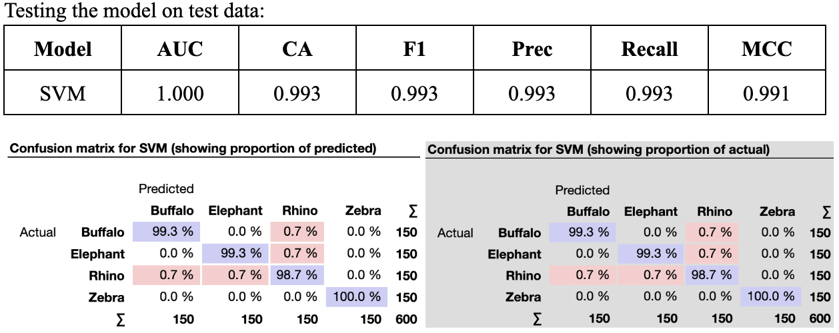
Post-Tuning SVM Evaluation
Final result of testing the model on test data after model tuning
Explanation about the figure {talk about model tuning (increased values), table, Conf Matrix}
Model Tuning {Tuned Values (C = 2.00, Numerical tolerance = 1.0000, Iteration limit = 1000)}
Difference {did produce higher accuracy (reduction of errors) but negligible difference}

Slide 10
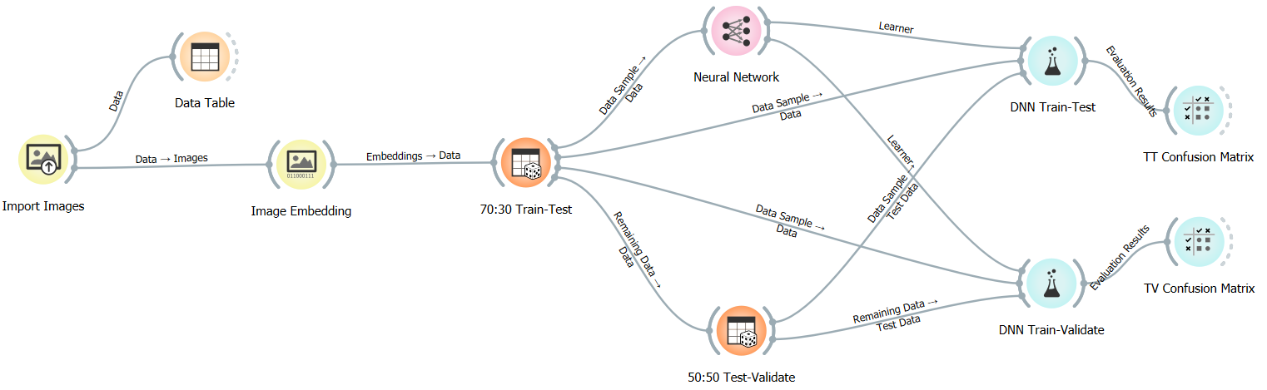
DNN Model
Created a model containing 7 layers of size 100, 100, 50, 50, 40, 20, 10.
Chose ReLu for Activation and Adam for Solver.
Gave an initial Regularization (ɑ) of 0.0001 and Maximal number of iterations of 200.
Values were chosen somewhat arbitrarily, with some being the defaults.

Slide 11
SVM/DNN Model Metrics
Area Under Curve (AUC): Measurement of the quality of the model’s predictions.
Classification Accuracy (CA): Percentage of correct classifications out of all classifications made.
F1 Score (F1): Harmonic mean of precision and recall.
Precision (Prec): Percentage of TP out of all positive classifications (TP+FP).
Recall: Percentage of TP out of all actual positives (TP+FN).
Matthews Correlation Coefficient (MCC): Secondary metric best used for unbalanced classification problems.
All metrics generated using Orange.

Slide 12
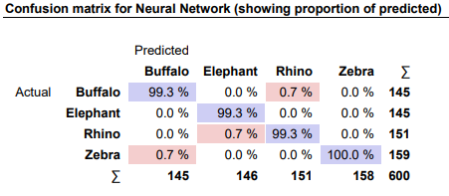
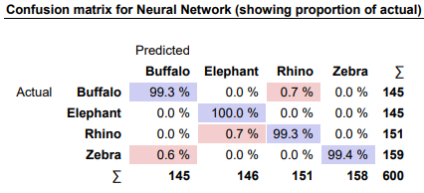
DNN Model
Model Testing on Test Data
Model | AUC | CA | F1 | Prec | Recall | MCC
Neur. Net | 1.000 | 0.995 | 0.995 | 0.995 | 0.995 | 0.993

Slide 13
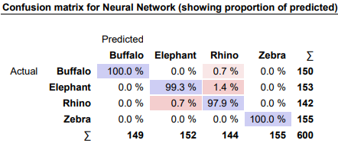
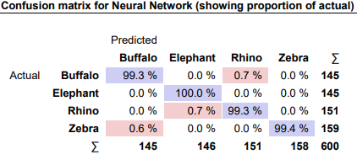
DNN Model
Model Testing on Validation Data
Model | AUC | CA | F1 | Prec | Recall | MCC
Neur. Net | 1.000 | 0.993 | 0.993 | 0.993 | 0.993 | 0.991

Slide 14
Final Comparison of Models
It was found that both models performed similarly after training them with the given dataset.
The SVM performed worse overall, even after tuning, but the difference was negligible.
The SVM took less time to train, meaning parameter tweaking could be done at a faster rate.
Further optimizations may be possible with the DNN, but rate of returns for improvement is severely diminished.

Slide 15
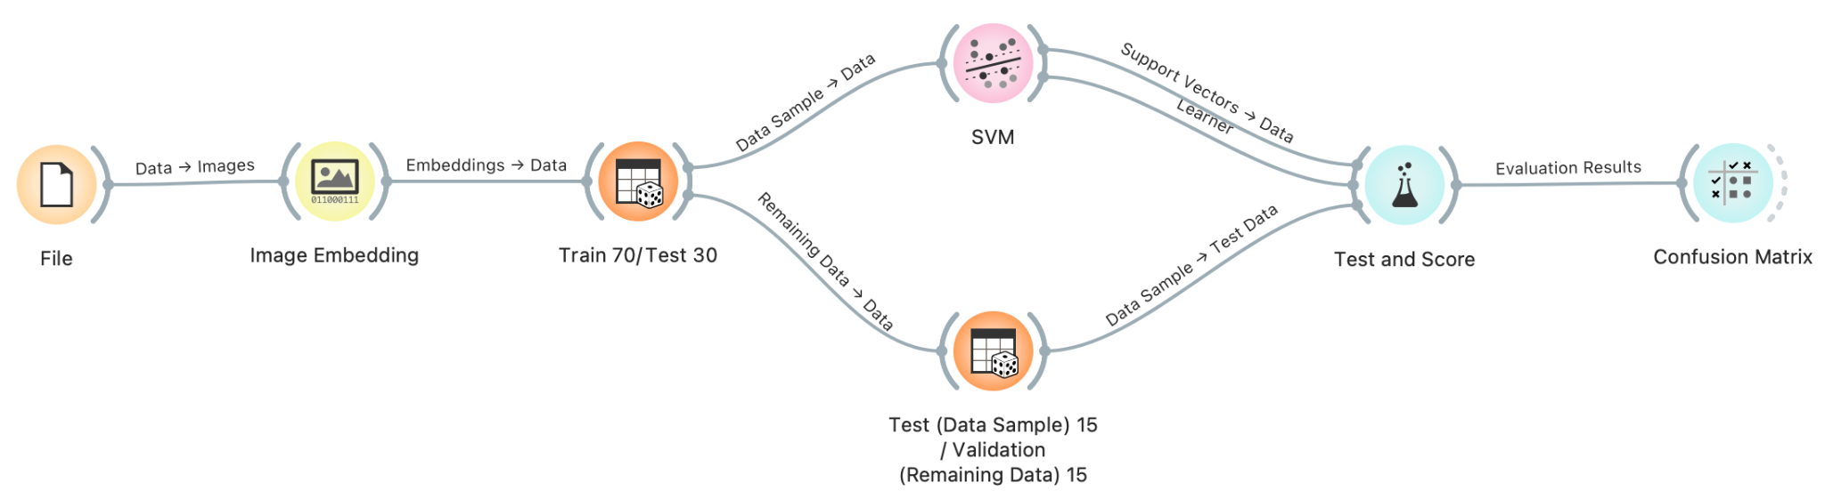
QUESTIONS?

